Slide 1
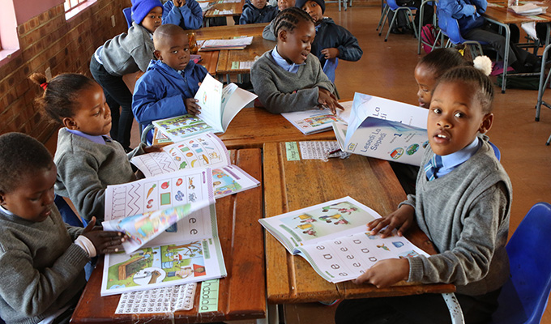





A Comparative Analysis of the Quality of Education for Girls in Ghana, Kenya, Nigeria, South Africa, and Zimbabwe (SDG 4)
Tech Divas
Group 1
Bootcamp Cohort 3.1

Slide 2
TABLE OF CONTENT
Introduction
Country Profile
Objectives
Key Indicators
Presentation of Data
Conclusion
Recommendations

Slide 3
INTRODUCTION
SDG 4, known as Quality Education, is a promise to make quality education available to everyone.
By 2030, the aim is to guarantee universal access to quality primary and secondary education, promote gender equality, and foster skills development, ultimately striving for inclusive and equitable education for all.
The primary objective of this project is to conduct a comprehensive analysis of the educational landscape in Ghana, Kenya, Nigeria, South Africa, and Zimbabwe. The analysis will focus on evaluating and comparing data from 2012 until 2022 on the quality of education provided in these countries against the benchmarks outlined in Sustainable Development Goal 4 (SDG 4) established by the United Nations

Slide 4





COUNTRY PROFILES
We used these five countries in Sub Sahara Africa as our Case study
NIGERIA
SOUTH AFRICA
ZIMBABWE
KENYA
GHANA

Slide 5
OBJECTIVES
Delve deeply into the various factors that shape enrollment trends of primary education in Sub Sahara Africa.
Also examine the completion rates of primary education, and the presence of trained teachers in Sub Sahara Africa.

Slide 6
KEY INDICATORS
Enrollment rate
Gross Intake Ratio
Completion rate
Out of School Rate
Adult Literacy Rate
Pupil-Teacher Ratio
Qualified Teachers
Government Expenditure on Education

Slide 7
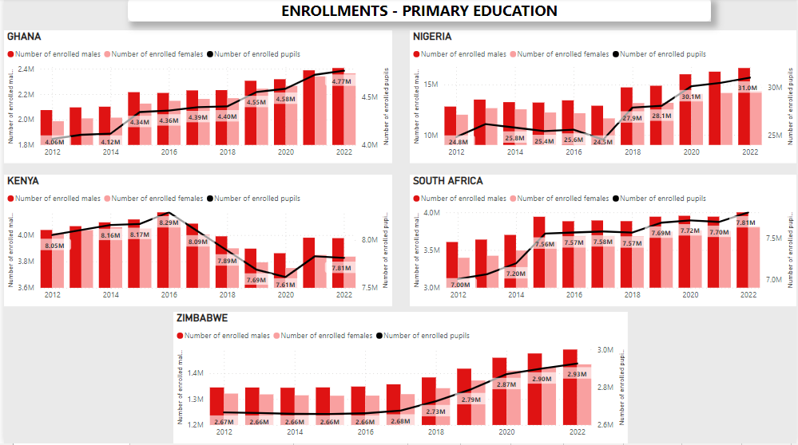
ENROLMENTS – PRIMARY EDUCATION
Notes:
Enrolments in all the countries individually.

Slide 8
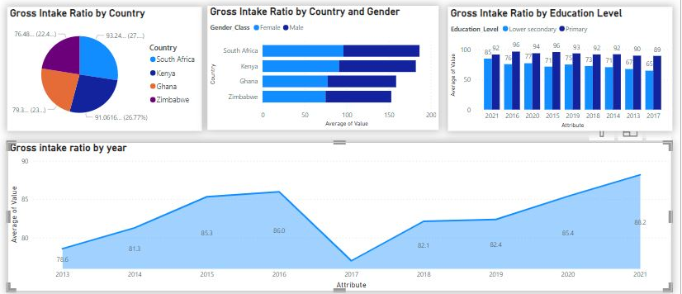
GROSS INTAKE RATIO TO LAST GRADE
Notes:
Percentage of students that get admitted from Primary and proceed to graduate

Slide 9
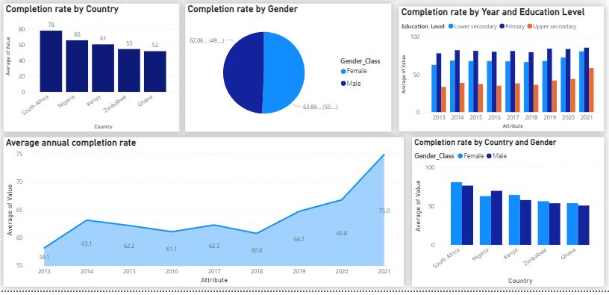
COMPLETION RATES

Slide 10
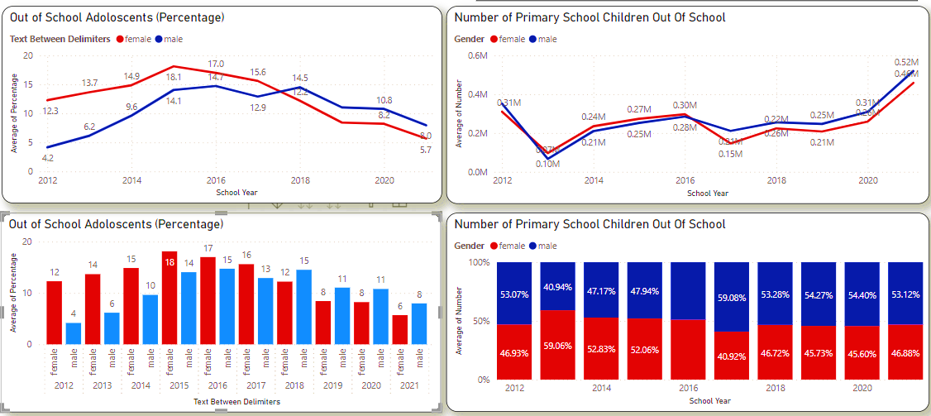
OUT-OF-SCHOOL RATES

Slide 11
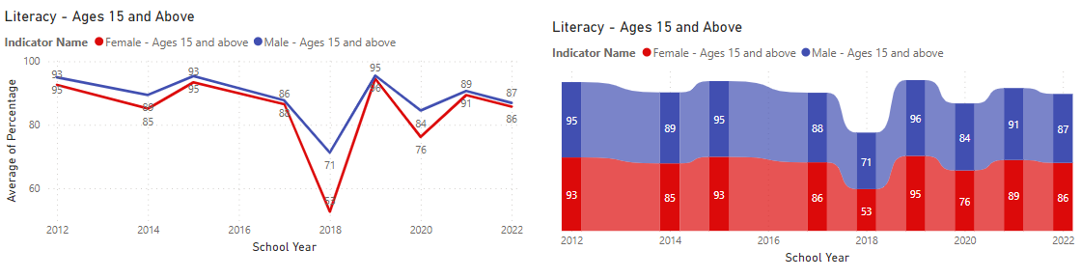
ADULT LITERACY RATE

Slide 12
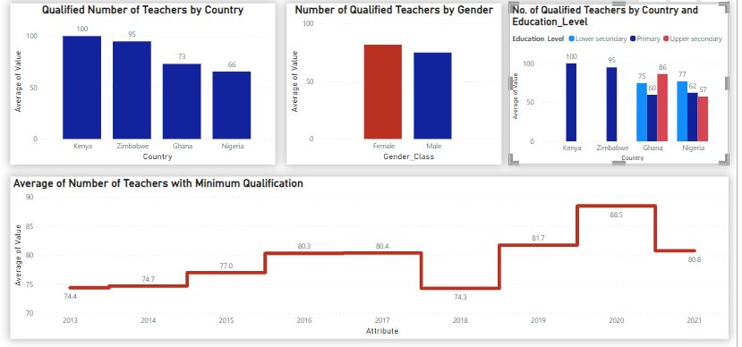
PROPORTION OF TEACHERS WITH MINIMUM QUALIFICATION
Notes:
Minimum qualifications for Lower and Uppwer Secondary – Average percentage

Slide 13
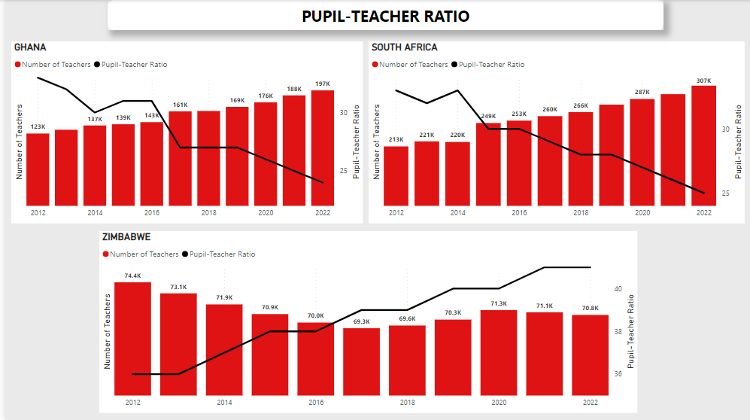
PUPIL – TEACHER RATIO

Slide 14
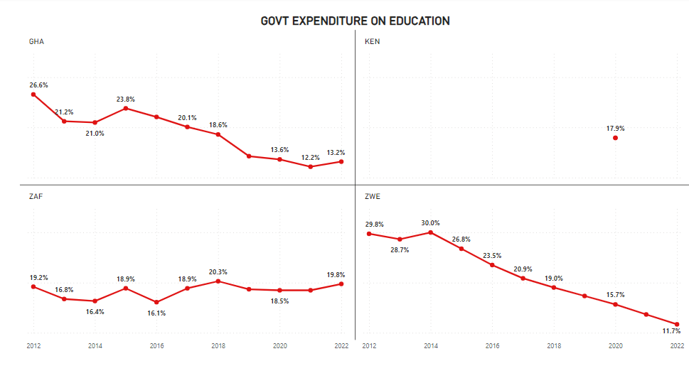
GOVERNMENT EXPENDITURE ON EDUCATION
Notes:
As apercentage of the GDP

Slide 15
OBSERVATIONS
Lack of complete data in some countries makes it difficult to measure and analyze
Increase in enrolment in Primary School enrolment on average
Increase in qualified teachers has directly contributed to the reduction in the pupil teacher ratio
Out of school ratio increased in the secondary categories affecting adult literacy rates negatively
Reduction in Government expenditure over the years. School fees may be a factor in the increase in Out of School ratios

Slide 16
RECOMMENDATIONS
Sensitization of the countries on the importance of making these data available consistently.
Increase in Primary school enrolments is commended and focus should be on maintaining the progress. Factors affecting Kenya’s decline in enrolment should be centered on and addressed by the Government
Increase in qualified teachers commended and should be maintained by all countries
Factors affecting children, resulting in them being out of school especially in Primary school where there is an increase, could be family, social, financial, psychological amongst many.
Recommend that Governments increase their funding to enable the Free-Education policy for schools in these countries

Slide 17
CONCLUSION
Males affected negatively more in recent years
75% of the goal of 100% (Completion Rate)
The Goal is attainable

